Slide 1
Remix: a web framework for the edge

Slide 2

About me
~20 years experience making silky smooth software, helping people and teams learn modern technologies, solving “weird” problems, and spreading mirth and merriment wherever I go.
Know a little bit about a lot of things. But more so about DevOps, Cloud, and “People Stuff”.
Professional imposter.
Microsoft TEALS Program Volunteer, Houston .NET Users Group President, St. Kevork Armenian Church Treasurer
BS CS and MBA from University of Houston (in Houston, TX)
Garo Yeriazarian
Software Whisperer – Product, Platforms and Engineering Services
@garoyeri

Slide 3
Product and Platform Engineering Services (PPES)
AT PPES, WE:
Unlocking the power of platforms
Design and build cloud-based, partner-rich platforms
Enable clients to become high-performance, future-forward businesses.
Bring our full selves to work, make a huge impact, and grow more than anywhere else

Slide 4
The Plan
01
Web browsers today
02
What is Remix and why is it pretty cool?
Remix is a new(ish) framework that focuses on web standards and creates a “happy path” for modern web application development. Let’s explore.
03
Walk through Lists of Gifts application
04
Hosting options
05
Questions and (probably) Answers!
##
Agenda item

Slide 5




What’s going on with web browsers today?
Fun stuff, I tell you what.

Slide 6
Internet Explorer is Dead. (it’s cool to cheer)

Slide 7
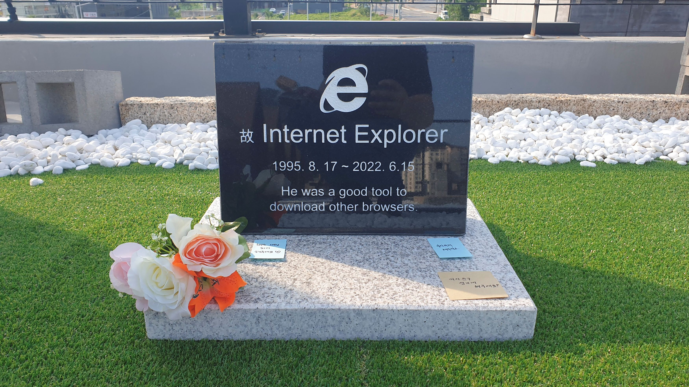
https://www.reuters.com/lifestyle/oddly-enough/internet-explorer-gravestone-goes-viral-south-korea-2022-06-17/

Slide 8
Edge (classic) is pretty much Dead. (also cool to cheer)

Slide 9
Web Browsers Today are Consolidating!
Blink + V8
Google Chrome
Microsoft Edge
Gecko + SpiderMonkey
Firefox
WebKit + JavaScriptCore
Safari
Brave
Opera
Chromium

Slide 10
Modern browsers are evergreen and support ES6+. (no more polyfills)

Slide 11
Compat 2021 and Interop 2022 (HTML / CSS standards are getting more standard)
Notes:
Compatibility on the web has always been a big challenge for developers. In the last couple of years, Google and other partners, including Mozilla and Microsoft, have set out to learn more about the top pain points for web developers, to drive our work and prioritization to make the situation better. This project is connected to Google's Developer Satisfaction (DevSAT) work, and it started on a larger scale with the creation of the MDN DNA (Developer Needs Assessment) surveys in 2019 and 2020, and a deep-dive research effort presented in the MDN Browser Compatibility Report 2020. Additional research has been done in various channels, such as the State of CSS and State of JS surveys.
The goal in 2021 is to eliminate browser compatibility problems in five key focus areas so developers can confidently build on them as reliable foundations. This effort is called #Compat 2021.
What is Interop 2022? #
Interop 2022 is a benchmark, agreed on by representatives of three major browser implementations, and developed through a process of public nomination and review with input from supporters Apple, Bocoup, Google, Igalia, Microsoft, and Mozilla.
The benchmark focuses on 15 areas, identified by developers as being particularly troublesome when they are missing or have compatibility issues across browsers. All browser vendors have agreed to focus on these areas, and everyone involved is excited to get started on making the experience of developing for the web measurably better.

Slide 12
Interop 2022 Focus Areas
Cascade Layers
Aspect Ratio
Color Spaces and Functions
Containment
Dialog Element
Forms
Scrolling
Subgrid
Typography and Encodings
Viewport Units
Web Compat
Flexbox
Grid
Sticky Positioning
Transforms
https://wpt.fyi/interop-2022

Slide 13
Browser compatibility and parity are at an all-time high
Focus more on building great websites and less on trying to figure out what will work in what browsers.

Slide 14
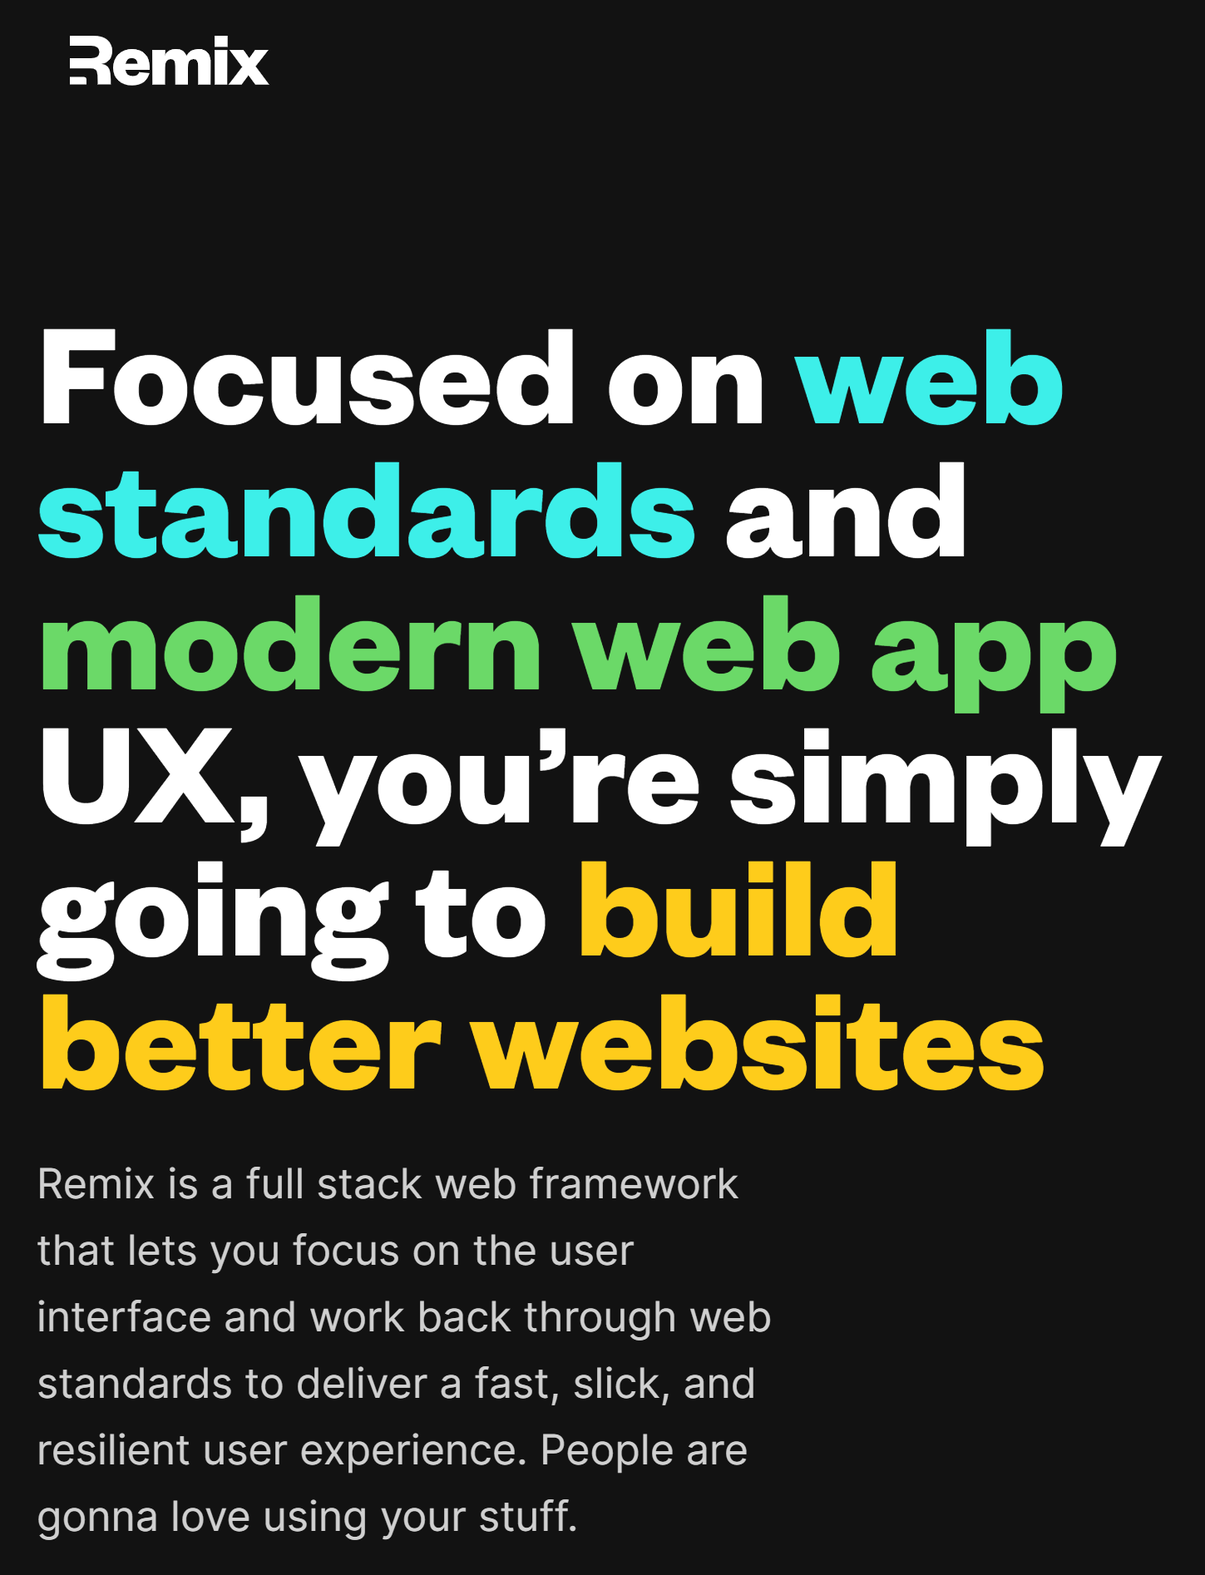
What is Remix and why’s it cool?
Better living through TypeScript.

Slide 15
How does Remix introduce Remix? Just go to https://remix.run

Slide 16
Embracing the HTML standards #useThePlatform Use <form> to do most of the heavy lifting

Slide 17
Use TypeScript / TSX for all the programming Streamline development cycles, improve team effectiveness

Slide 18
Nested routes + server rendered content Use prefetch links to get the browser to load and render content faster, reducing “jank”

Slide 19
Progressively enhance with JavaScript Instead of “degrading gracefully”, “enhance opportunistically”

Slide 20
Use new high-performance tooling: “vite” & “esbuild” New tools written natively introduce 10x-100x speed improvements in development cycles

Slide 21
Runs on servers and on edge functions Built on Web Fetch API instead of Node, can run on Deno (working on Bun.sh)

Slide 22
Use the platform
Browsers have feelings too.

Slide 23
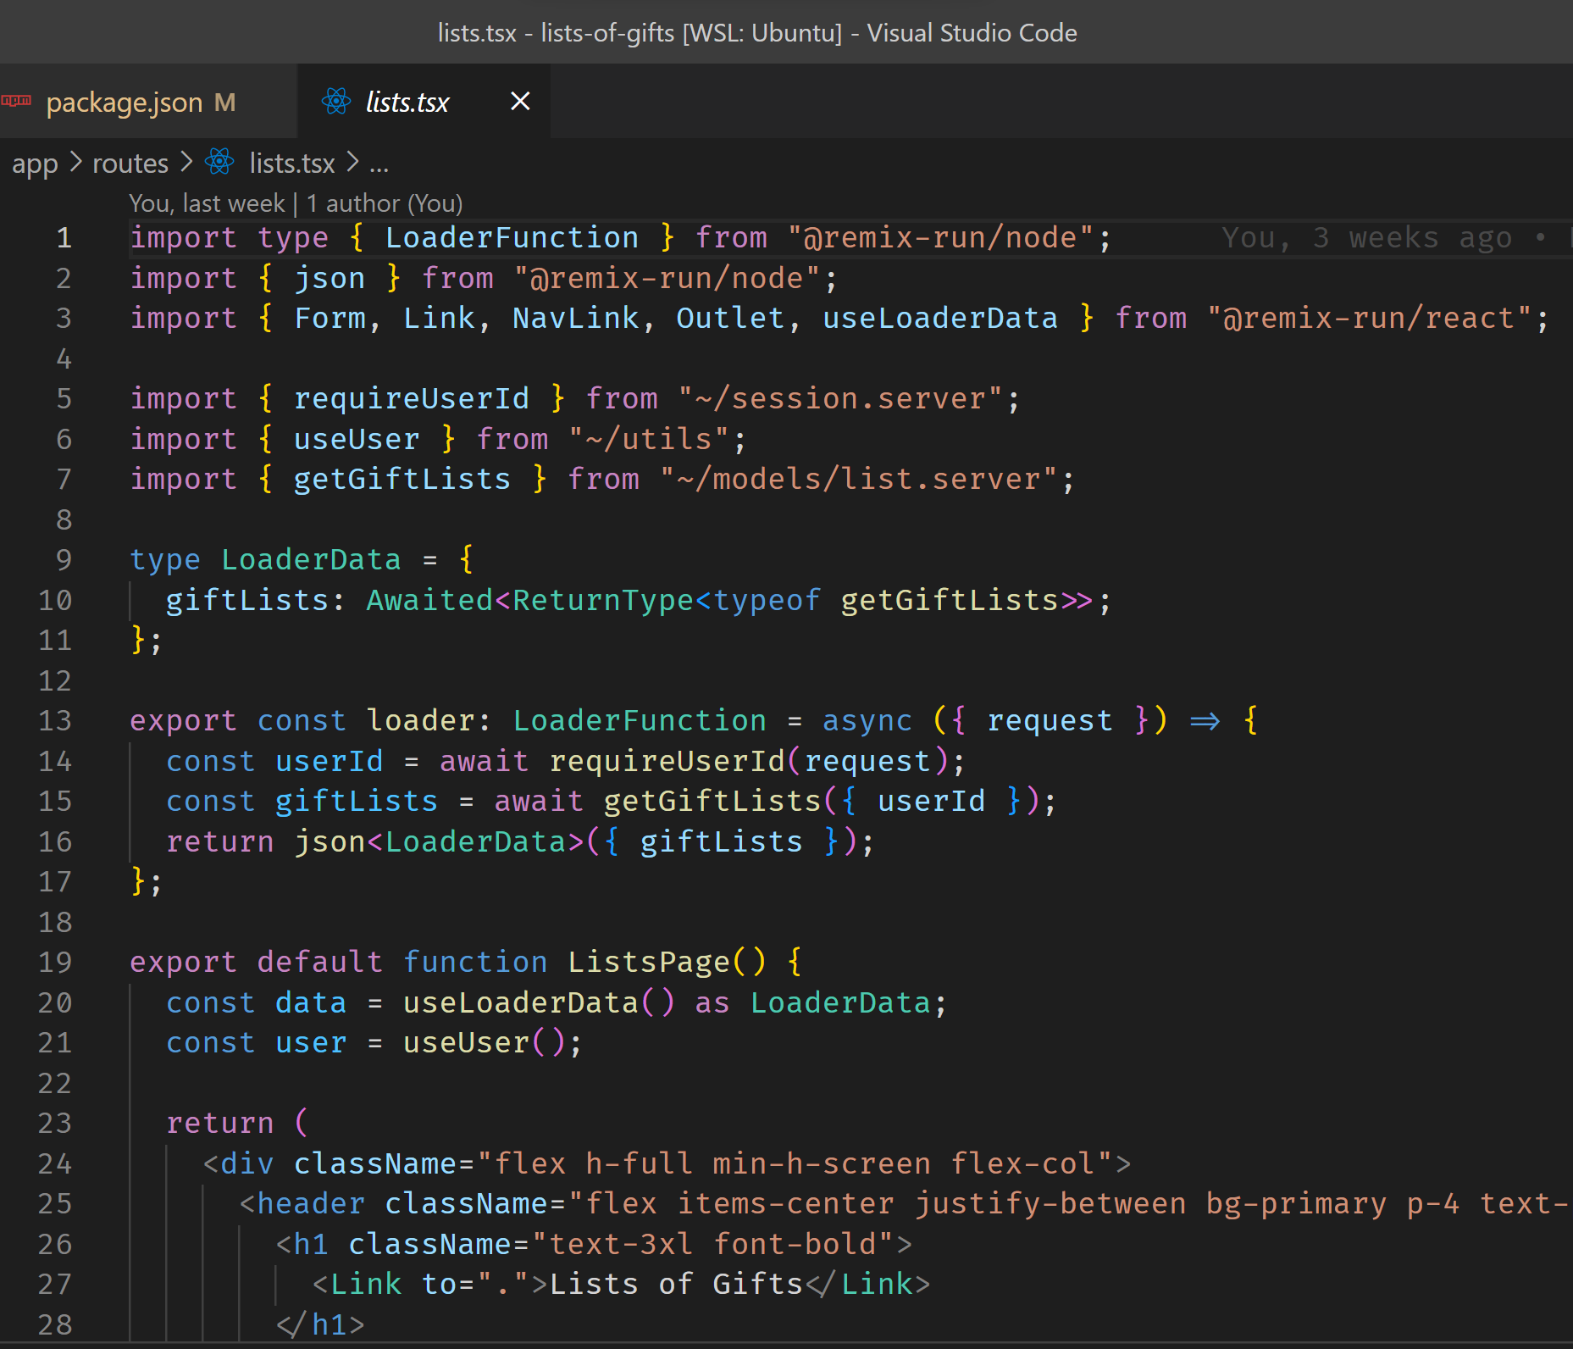
Let’s look at some Remix code
Walking through some of the “neat” stuff that improve productivity.

Slide 24
Views, Loaders, Actions Simplest part of Remix to show, and the most common one you’ll use

Slide 25
Nested Routes Organizing the code base to make nice URLs and easier access

Slide 26
Prisma Cool JS/TS library for object-relational mapping and schema migrations

Slide 27
Progressive Enhancement Start simple, add more complex interactions when necessary

Slide 28
Questions? Answers?

Slide 29
Let’s keep the conversation going!
www.accenture.com/PPES
garo.yeriazarian@accenture.com
@garoyeri
Visit our booth (look for the button maker & blue balloons)
And don’t forget to connect:

Slide 30




















































Titanium Sponsors
Speaker Dinner Sponsor
Platinum Sponsors
Gold Sponsors

